Slide 1
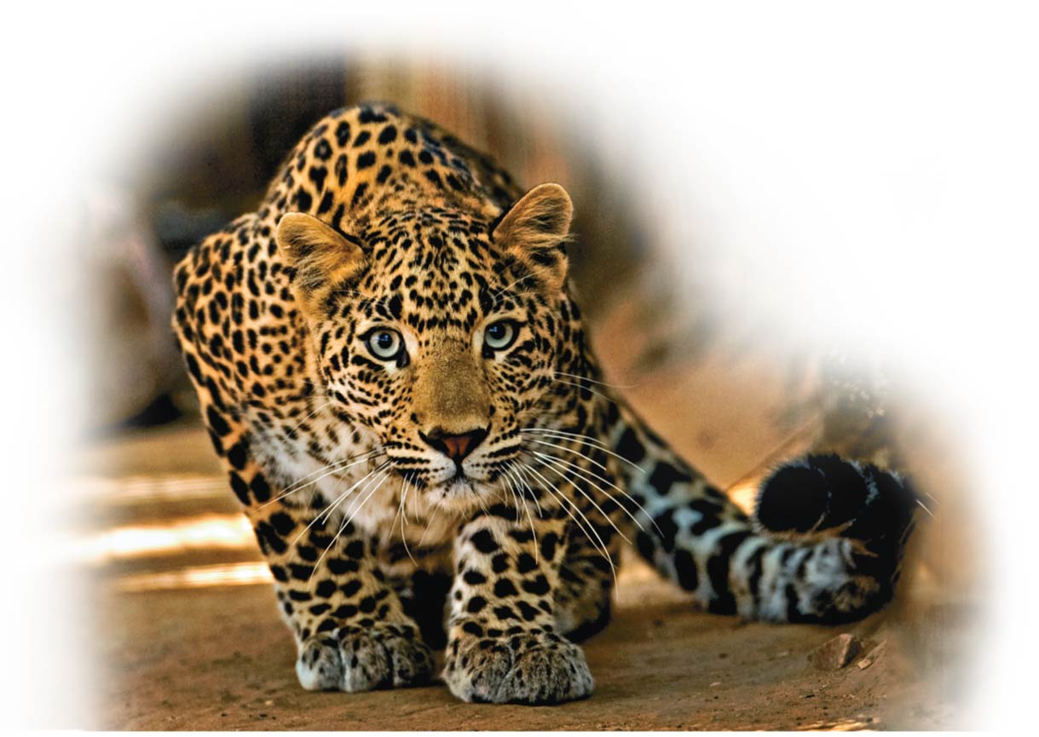
The Molecules of Life
Unit 1; Chapter 3

Slide 2
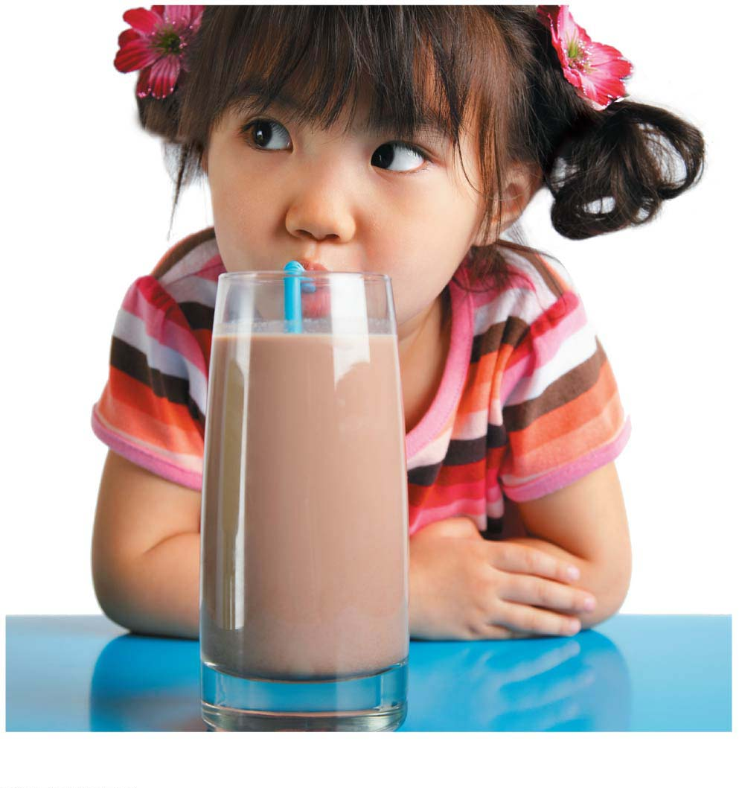
Chapter Thread: Lactose Intolerance（乳糖不耐受）
Notes:
Figure 3.0-2 Lactose intolerance: lactose-rich chocolate milk

Slide 3
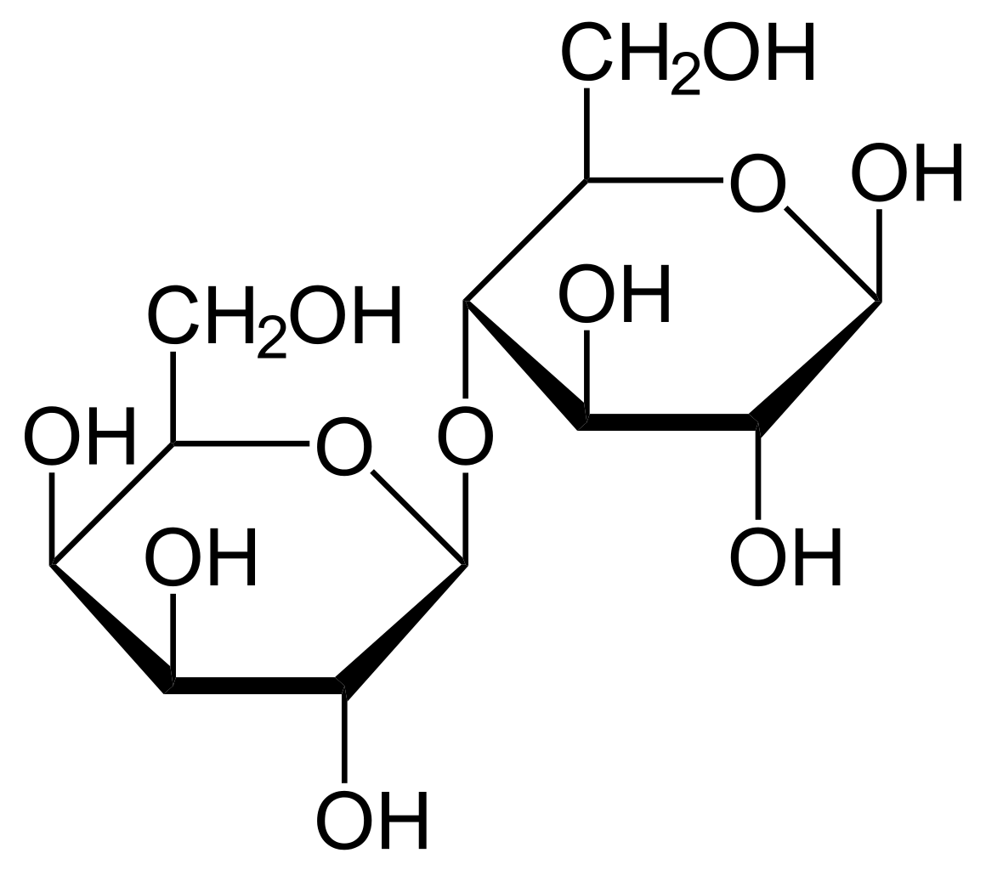
Biology and Society: Got Lactose?
Lactose is the main sugar found in milk.
Lactose intolerance is the inability to properly digest lactose.
Instead of lactose being broken down and absorbed in the small intestine（小肠）, lactose is broken down by bacteria in the large intestine, producing gas and discomfort.
Lactose
Notes:
3

Slide 4
Biology and Society: Got Lactose?
Lactose intolerance can be addressed by
avoiding lactose-containing foods or
consuming lactase（乳糖酶）pills along with food.
Notes:
4

Slide 5
Organic Compounds
Organic compounds are carbon-based molecules.
Most compounds found in a cell are carbon-based molecules.
Carbon forms large, complex, and diverse molecules necessary for life’s functions.
Notes:
5

Slide 6
Carbon Chemistry
Carbon is a versatile molecule.
Carbon can share electrons with other atoms in four covalent bonds.
Because carbon can use one or more of its bonds to attach to other carbon atoms, it is possible to construct an endless diversity of carbon skeletons varying in
size and
branching pattern.
Notes:
6

Slide 7
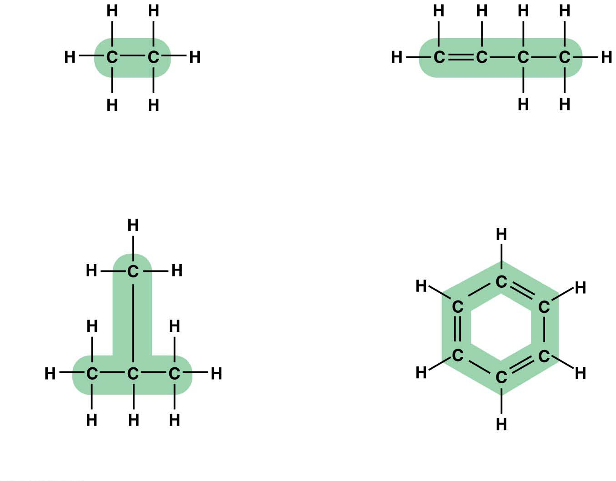
Double bond
Carbon skeletons vary in length
Carbon skeletons may
have double bonds,
which can vary in location
Carbon skeletons may be
unbranched or branched
Carbon skeletons may
be arranged in rings
Notes:
Figure 3.1 Variations in carbon skeletons

Slide 8
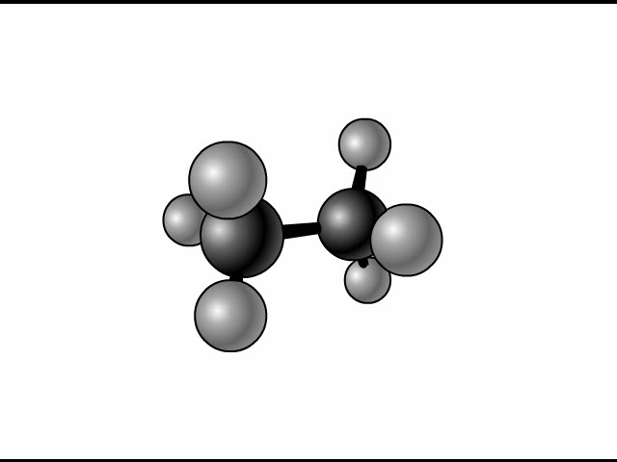
Animation: Carbon Skeletons

Slide 9
Carbon Chemistry
The carbon atoms of organic compounds can also bond with other elements, most commonly
hydrogen,
oxygen, and
nitrogen.
Notes:
9

Slide 10
Carbon Chemistry
One of the simplest organic compounds is methane (甲烷), CH₄, with a single carbon atom bonded to four hydrogen atoms.
Methane is abundant in natural gas and is produced
by prokaryotes (原核生物) that live in swamps, i.e., swamp gas (沼气), and
in the digestive tracts (消化系统) of grazing animals (食草动物), such as cows.
Notes:
10

Slide 11
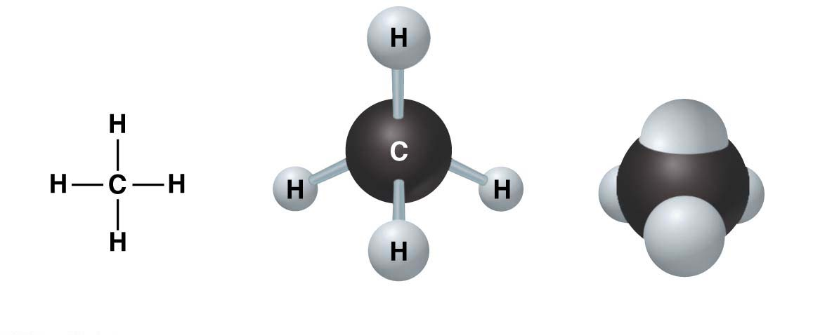
Structural formula
Ball-and-stick model
Space-filling model
Notes:
Figure 3.2 Methane, a simple organic compound

Slide 12
Carbon Chemistry
Larger organic compounds
are the main molecules in gasoline we burn in cars and other machines and
are important fuels in your body.
The energy-rich parts of fat molecules have a structure similar to gasoline.
Notes:
12

Slide 13
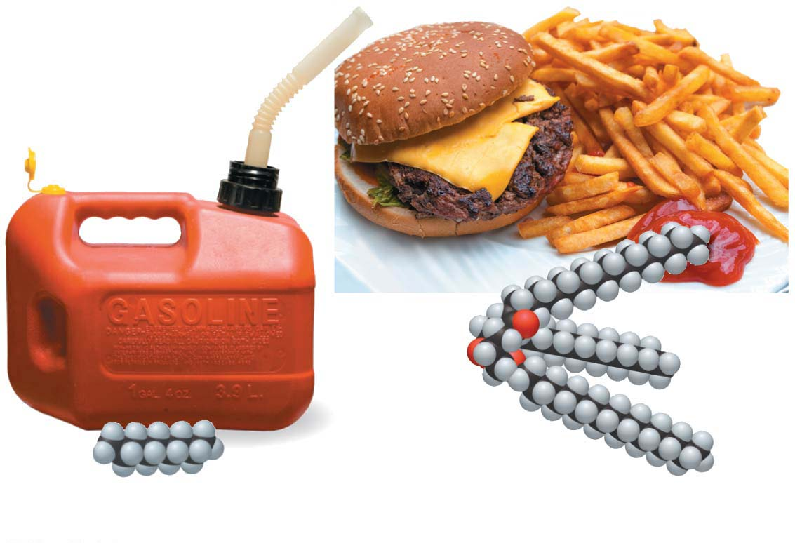
Octane（辛烷）
Dietary fat（膳食脂肪）
Notes:
Figure 3.3 Hydrocarbons as fuel

Slide 14
Carbon Chemistry
The unique properties of an organic compound depend on
its carbon skeleton and
the atoms attached to the skeleton.
Notes:
14

Slide 15
Carbon Chemistry
In an organic compound, the groups of atoms directly involved in chemical reactions are called functional groups.
Each functional group plays a particular role during chemical reactions.
Many biological molecules have two or more functional groups.
Notes:
15

Slide 16
Giant Molecules from Smaller Building Blocks
On a molecular scale, many of life’s molecules are gigantic, earning the name macromolecules.
Three categories of macromolecules are
carbohydrates,
proteins, and
nucleic acids（核酸）.
Notes:
16

Slide 17
Giant Molecules from Smaller Building Blocks
Macromolecules are polymers（聚合物）.
Polymers are made by stringing together many smaller molecules called monomers（单体）.
A dehydration（脱水） reaction
links two monomers together and
removes a molecule of water.
Notes:
17

Slide 18
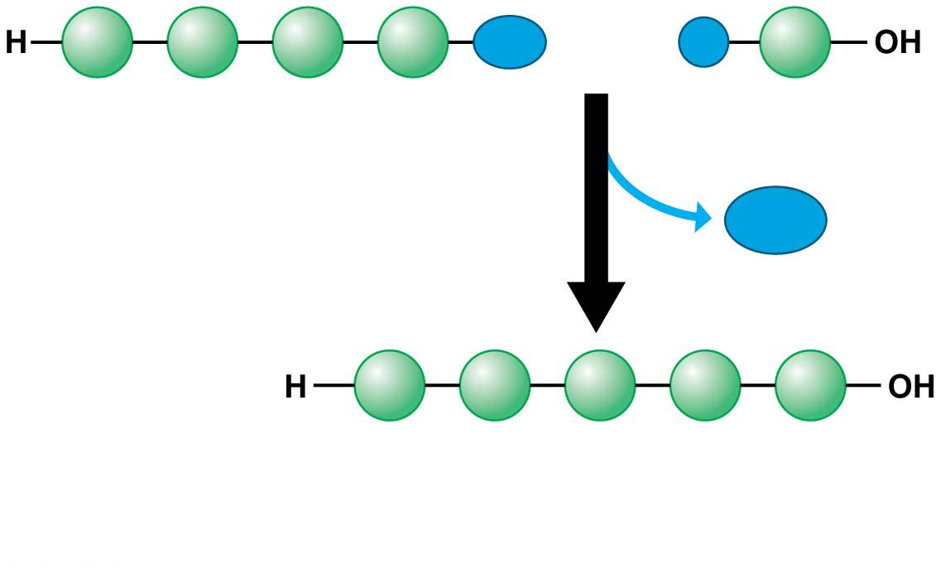
OH
H
Short polymer
聚合物
Monomer
单体
Dehydration
reaction
H₂O
脱水
Longer polymer
(a) Building a polymer chain
Catalyzed by a polymerase enzyme
Notes:
Figure 3.4-1 Synthesis and breakdown of polymers (part 1: synthesis)

Slide 19
Giant Molecules from Smaller Building Blocks
Organisms also have to break down macromolecules.
Digestion（消化作用） breaks down macromolecules to make monomers available to your cells.
Notes:
19

Slide 20
Giant Molecules from Smaller Building Blocks
Hydrolysis（水解作用）
breaks bonds between monomers,
adds a molecule of water, and
reverses the dehydration reaction.

Slide 21
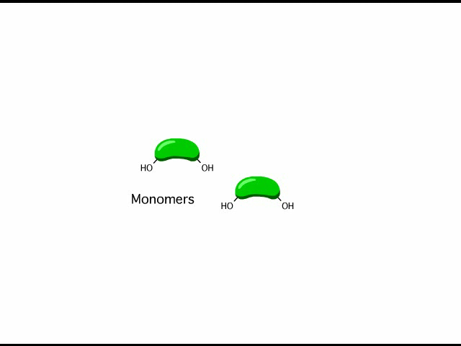
Animation: Polymers

Slide 22
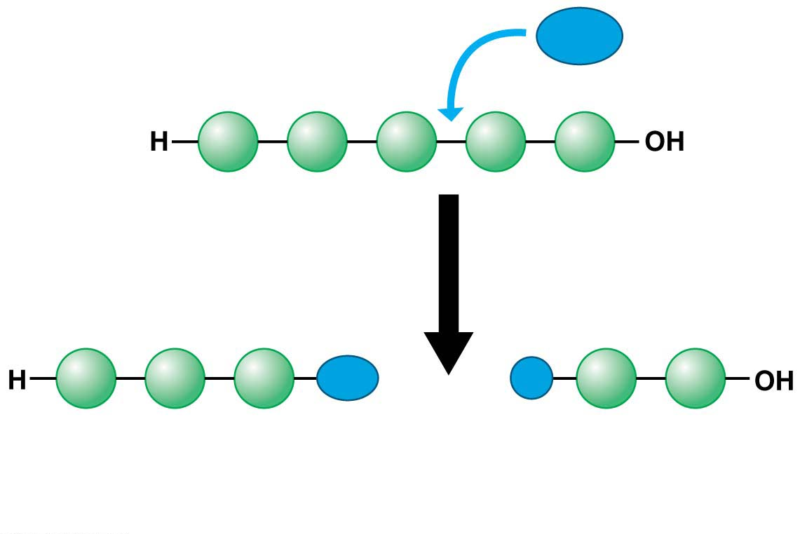
H₂O
Hydrolysis
OH
H
(b) Breaking a polymer chain
Catalyzed by a hydrolase enzyme
Notes:
Figure 3.4-2 Synthesis and breakdown of polymers (part 2: breakdown)

Slide 23
Large Biological Molecules
There are four categories of large biological molecules found in all living creatures:
carbohydrates,
lipids,
proteins, and
nucleic acids.
Notes:
23

Slide 24
Carbohydrates（碳水化合物）
Carbohydrates include sugars and polymers of sugar. Examples are
small sugar molecules in soft drinks and
long starch molecules in spaghetti and bread.
Notes:
24

Slide 25
Carbohydrates
In animals, carbohydrates are
a primary source of dietary energy and
raw material for manufacturing other kinds of organic compounds.
In plants, carbohydrates serve as a building material for much of the plant body.
Notes:
25

Slide 26
Monosaccharides（单糖）
Monosaccharides
are the monomers of carbohydrates and
cannot be broken down into smaller sugars.
Common examples are glucose（葡萄糖） in sports drinks and fructose（果糖） found in fruit.
Both of these simple sugars are also found in honey.
Sacchar = sugar
Notes:
26

Slide 27
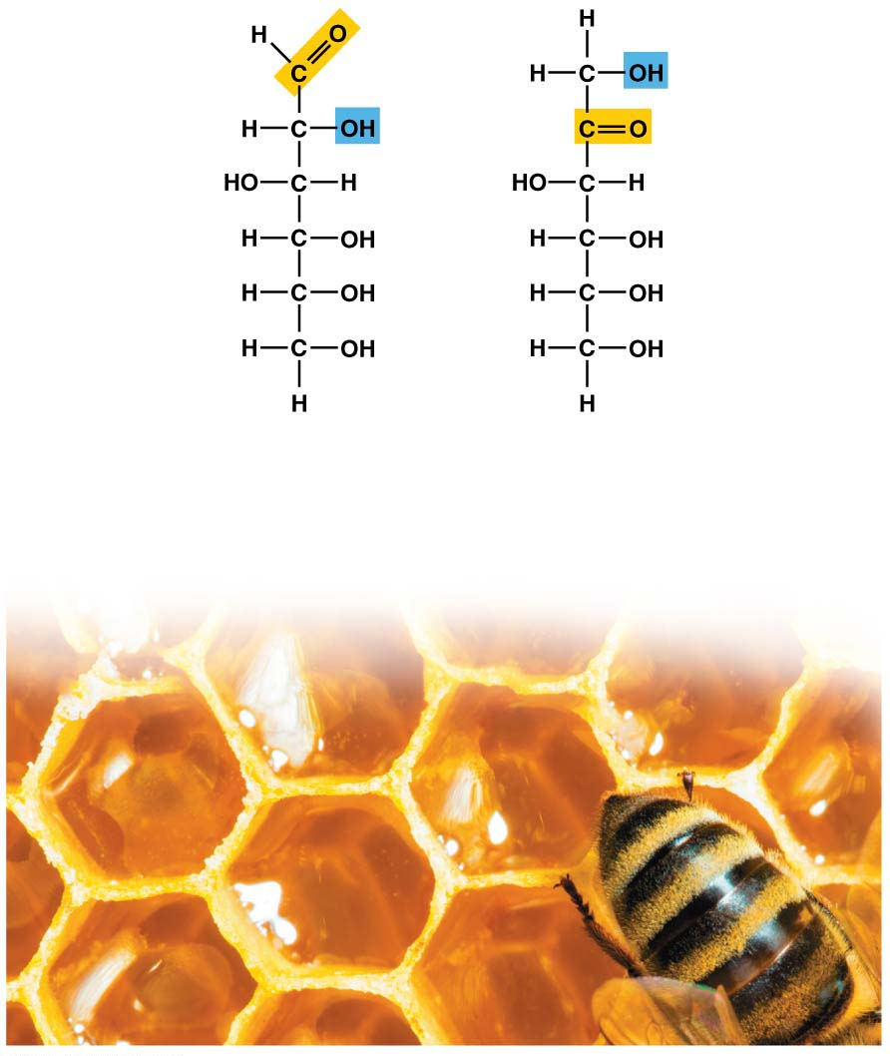
Glucose
Fructose
C₆H₁₂O₆
C₆H₁₂O₆
Isomers
(same formula, different arrangements)
Notes:
Figure 3.5 Monosaccharides (simple sugars)

Slide 28
Monosaccharides
Glucose and fructose are isomers（同分异构体）, molecules that have the same molecular formula but different structures.
Notes:
28

Slide 29
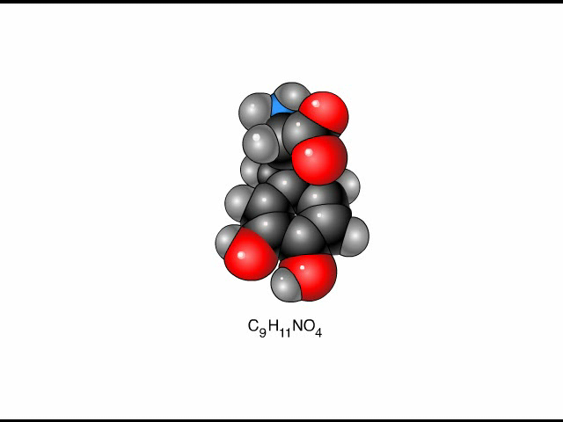
Animation: L-Dopa

Slide 30
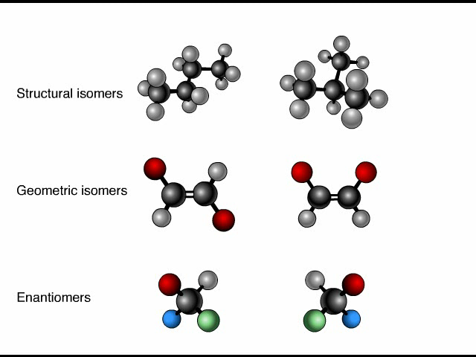
Animation: Isomers
结构异构
几何异构
(Cis-trans isomers)
对映异构

Slide 31
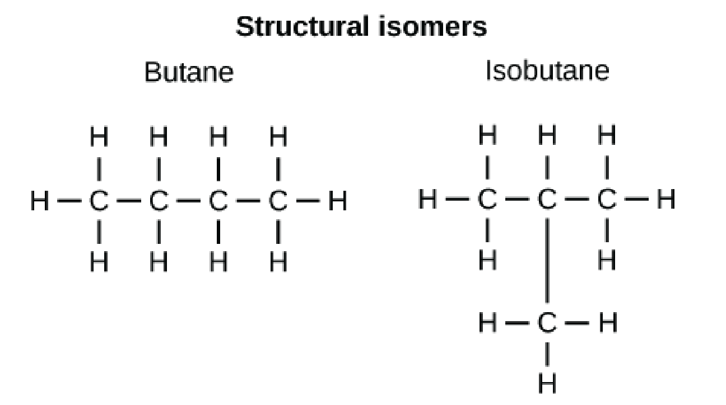
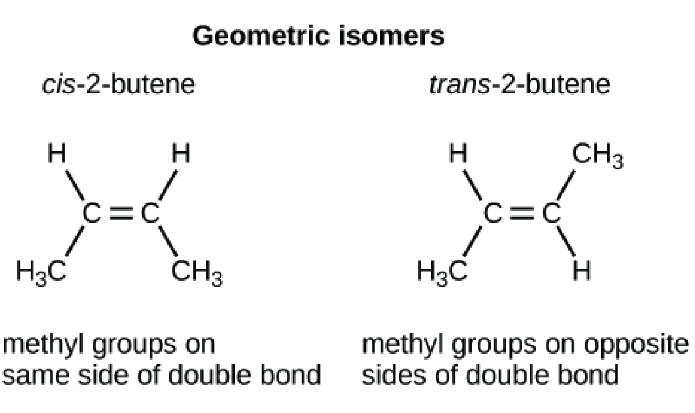
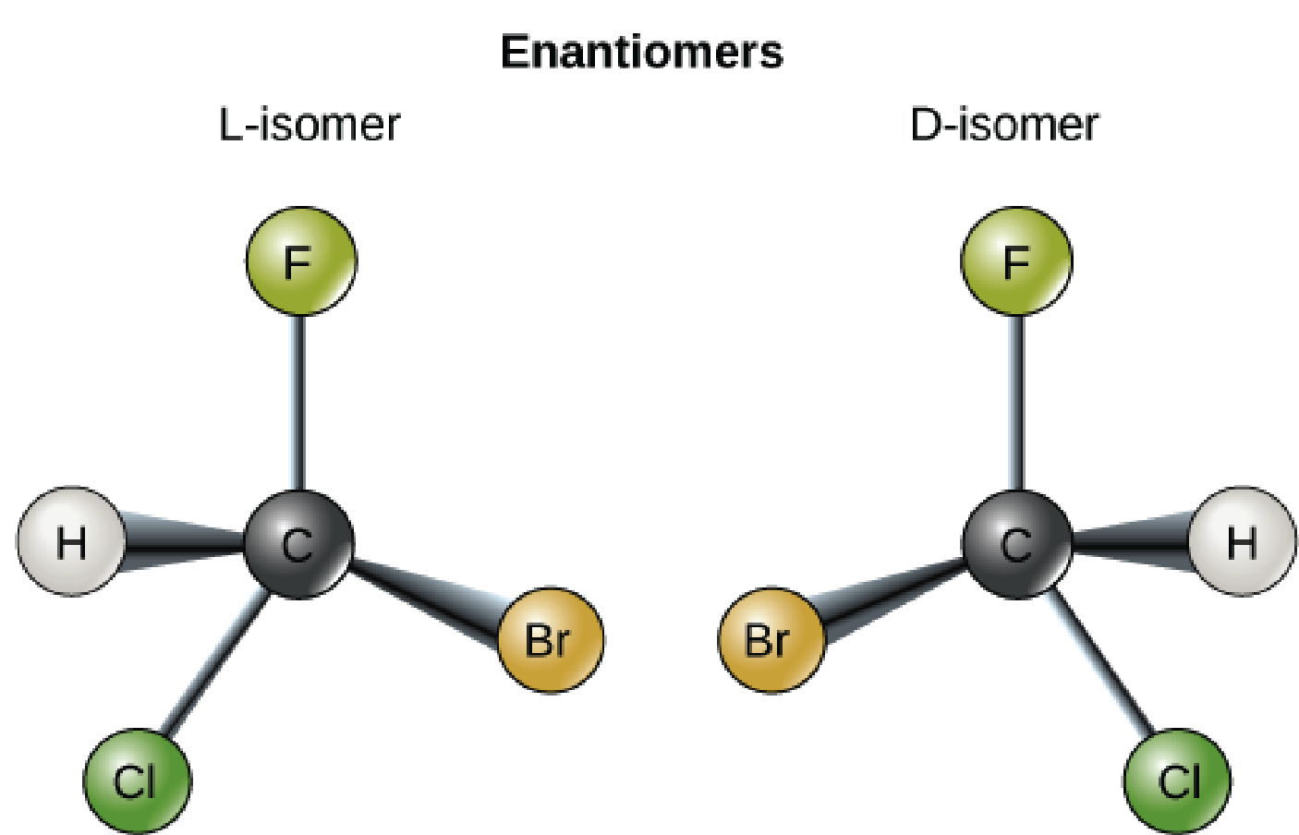

Slide 32
Monosaccharides
Monosaccharides, particularly glucose, are the main fuels for cellular work.
In water, many monosaccharides form a ring structure.
Notes:
32

Slide 33
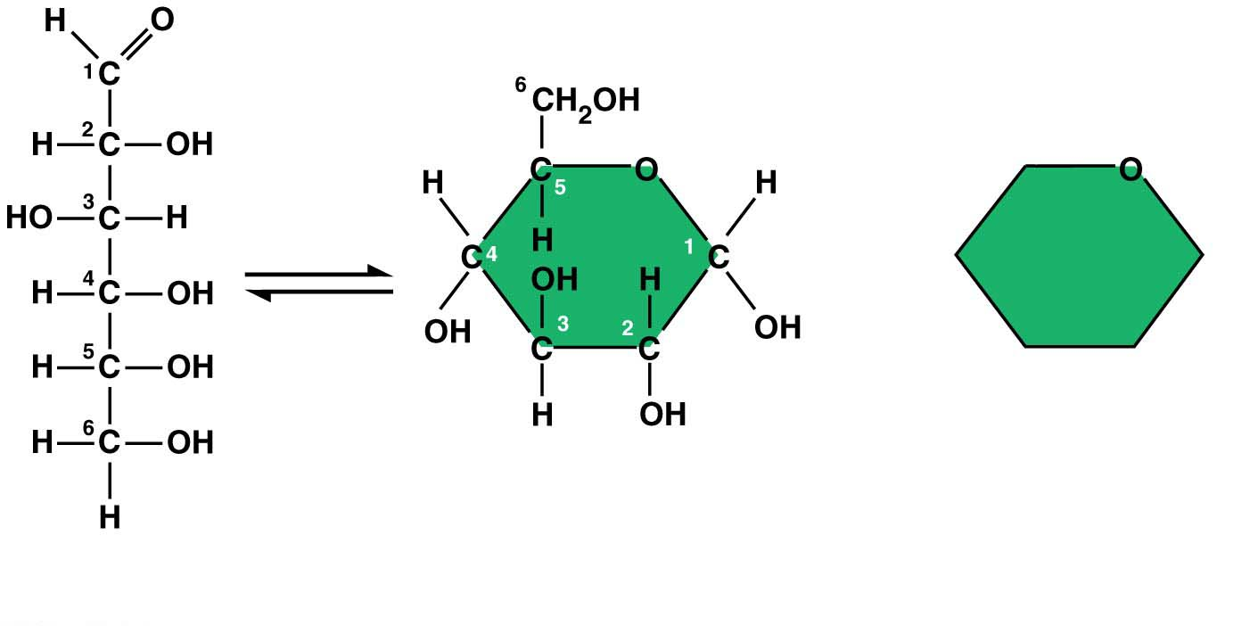
(a) Linear and ring structures
(b) Abbreviated ring
structure
Notes:
Figure 3.6 The ring structure of glucose

Slide 34
Disaccharides（双糖）
A disaccharide is a double sugar constructed from two monosaccharides by a dehydration reaction.
Notes:
34

Slide 35
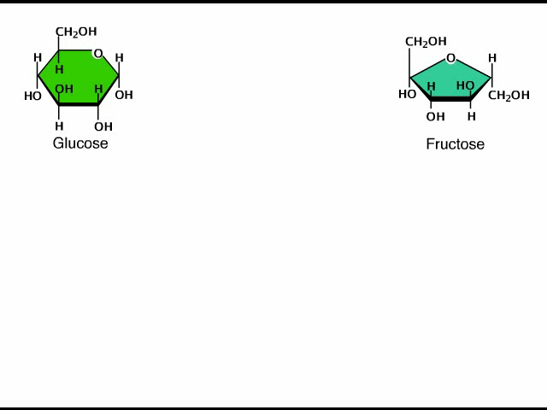
Animation: Disaccharides

Slide 36
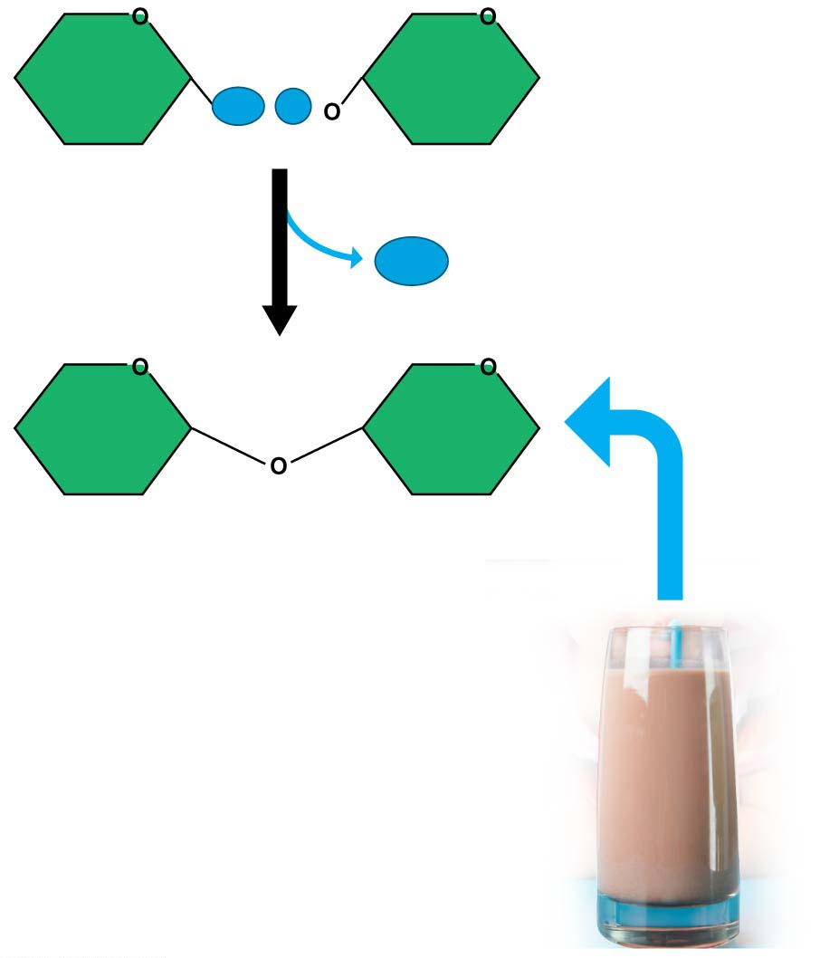
Figure 3.7
OH
H
Glucose
Galactose（半乳糖）
H₂O
Lactose（乳糖）
Notes:
Figure 3.7 Disaccharide (double sugar) formation

Slide 37
Disaccharides
Disaccharides include
lactose in milk, made from the monosaccharides glucose and galactose,
Maltose（麦芽糖） in beer, malted milk shakes, and malted milk ball candy, and
Sucrose（蔗糖） in table sugar.
Notes:
37

Slide 38
Disaccharides
Sucrose is the main carbohydrate in plant sap.
High-fructose corn syrup (HFCS)（高果葡糖浆） is made by a commercial process that converts natural glucose in corn syrup（玉米糖浆） to much sweeter fructose.
HFCS is often one of the first ingredients listed in soft drinks.
Notes:
38

Slide 39
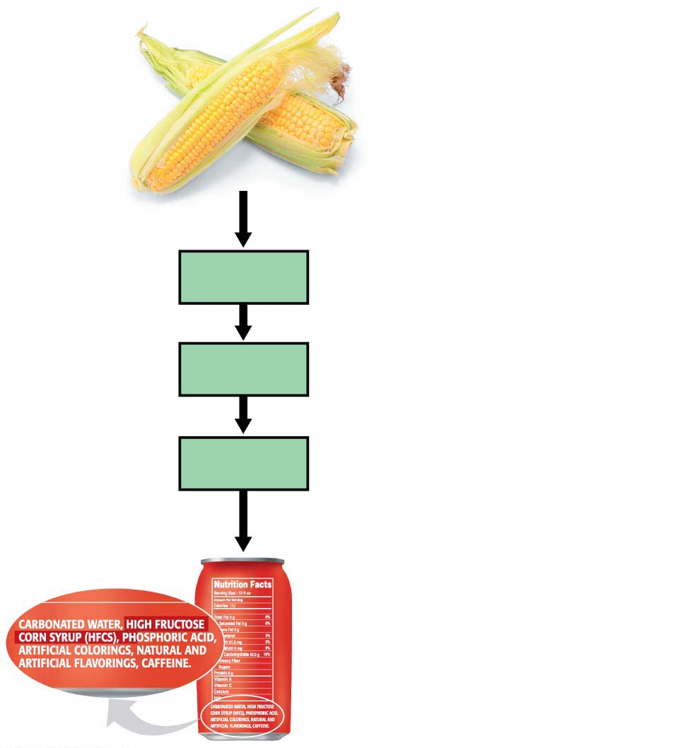
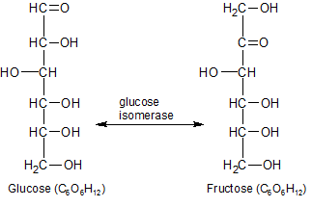
processed to extract
Starch
淀粉
broken down into
Glucose
converted via enzyme to sweeter
Fructose
added to foods as
high-fructose corn syrup
Notes:
Figure 3.8 High-fructose corn syrup

Slide 40
Disaccharides
Common forms: sucrose and high-fructose corn syrup.
Sugar
is a major cause of tooth decay;
overconsumption increases the risk of developing type 2 diabetes（糖尿病） and heart disease.
Notes:
40

Slide 41
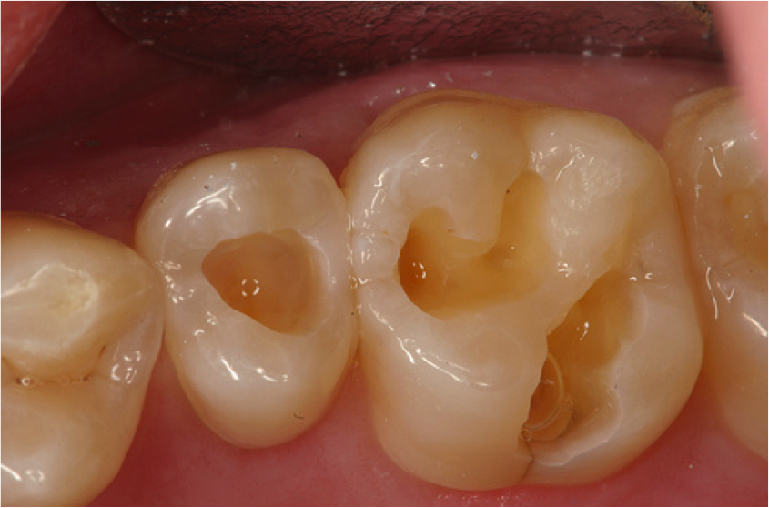
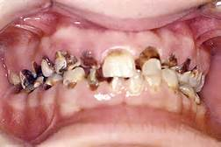
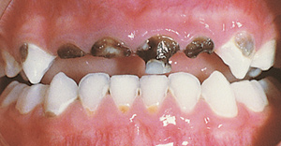
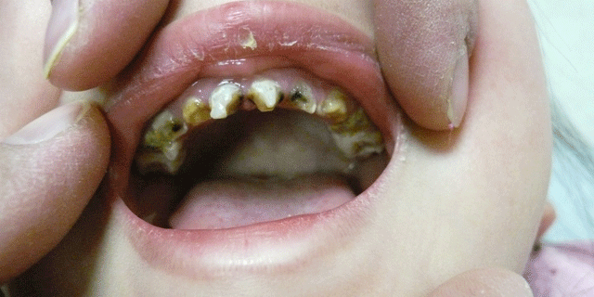

Slide 42
Polysaccharides（多糖）
Polysaccharides
are complex carbohydrates and
are made of long chains of sugars—polymers of monosaccharides.
Notes:
42

Slide 43
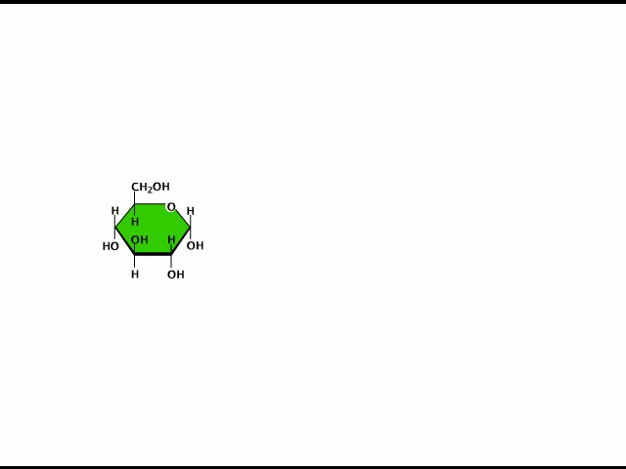
Animation: Polysaccharides

Slide 44
Polysaccharides（多糖）
Starch （淀粉）
is a familiar example of a polysaccharide,
consists of long strings of glucose monomers, and
is used by plant cells to store energy.
Potatoes and grains are major sources of starch in our diet.
Notes:
44

Slide 45
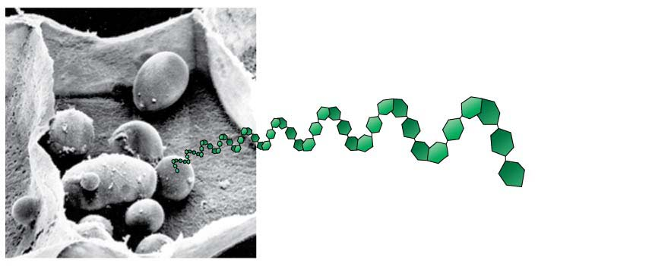
Starch granules
in potato tuber cells
Notes:
Figure 3.9-1 Three common polysaccharides (part 1: starch)

Slide 46
Polysaccharides
Glycogen（糖原）
is used by animal cells to store energy and
is broken down to release glucose when you need energy.
Notes:
46

Slide 47
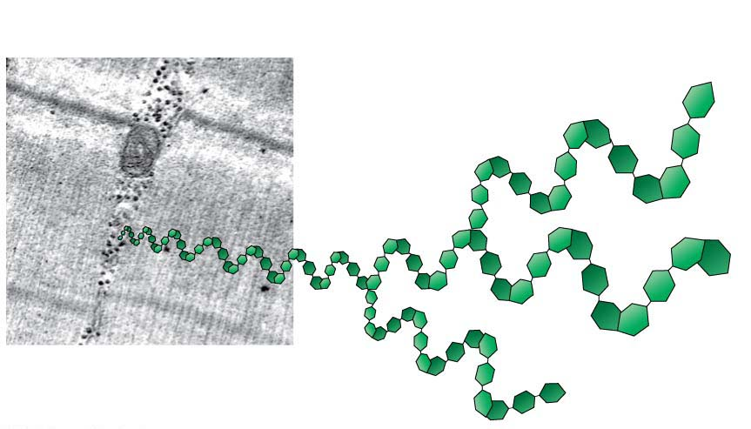
Glycogen granules
in muscle
tissue
Notes:
Figure 3.9-2 Three common polysaccharides (part 2: glycogen)

Slide 48
Polysaccharides
Cellulose（纤维素）
is the most abundant organic compound on Earth,
forms cable-like fibrils（原纤维） in the walls that enclose plant cells, and
cannot be broken by any enzyme produced by animals!
Notes:
48

Slide 49
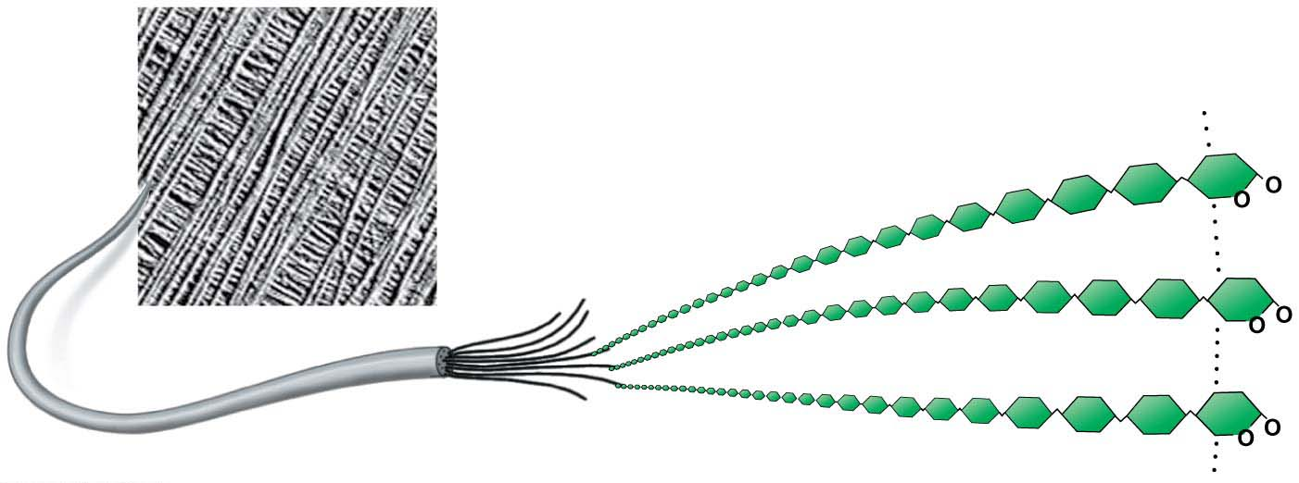
Cellulose microfibrils
in a plant cell wall
Cellulose
molecules
Notes:
Figure 3.9-3 Three common polysaccharides (part 3: cellulose)

Slide 50
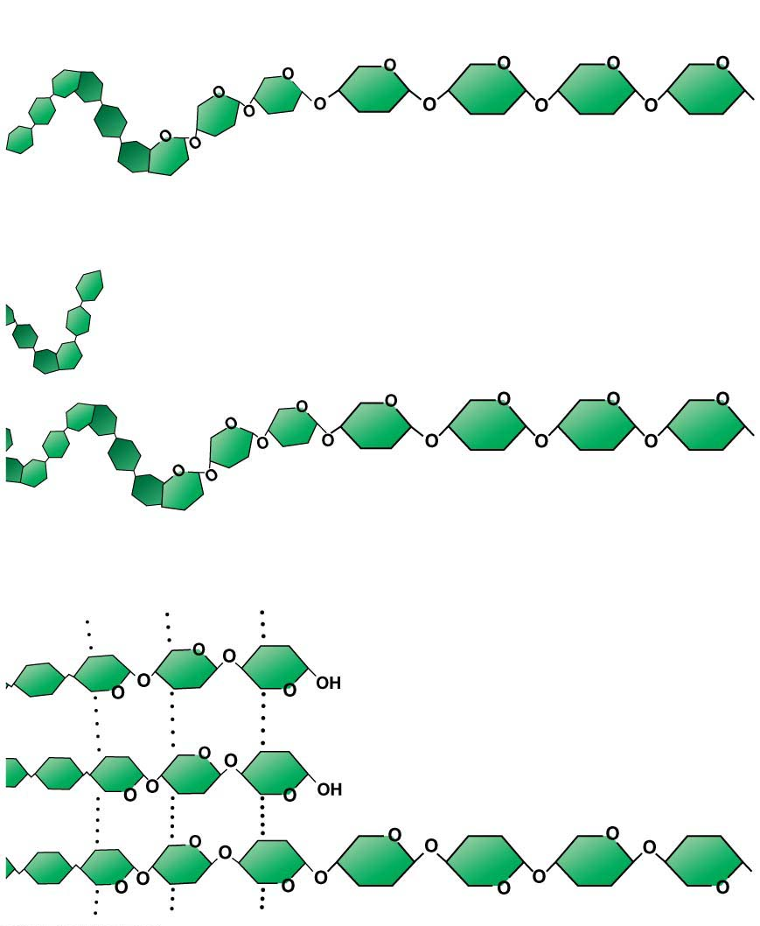
(a) Starch
Glucose
monomer
(b) Glycogen
(c) Cellulose
Hydrogen bonds
Notes:
Figure 3.9-4 Three common polysaccharides (part 4: comparison of structure)

Slide 51
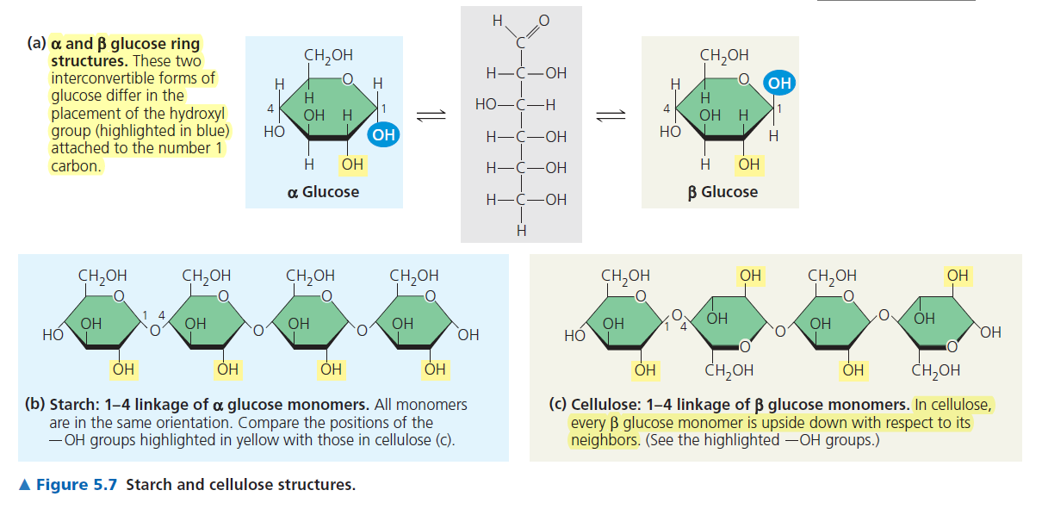

Slide 52
Lipids（脂类）
Almost all carbohydrates are hydrophilic (“water-loving”) molecules that dissolve readily in water.
Lipids are hydrophobic, unable to mix with water.
When you combine oil and vinegar, the oil, which is a type of lipid, separates from the vinegar, which is mostly water.
Notes:
52

Slide 53
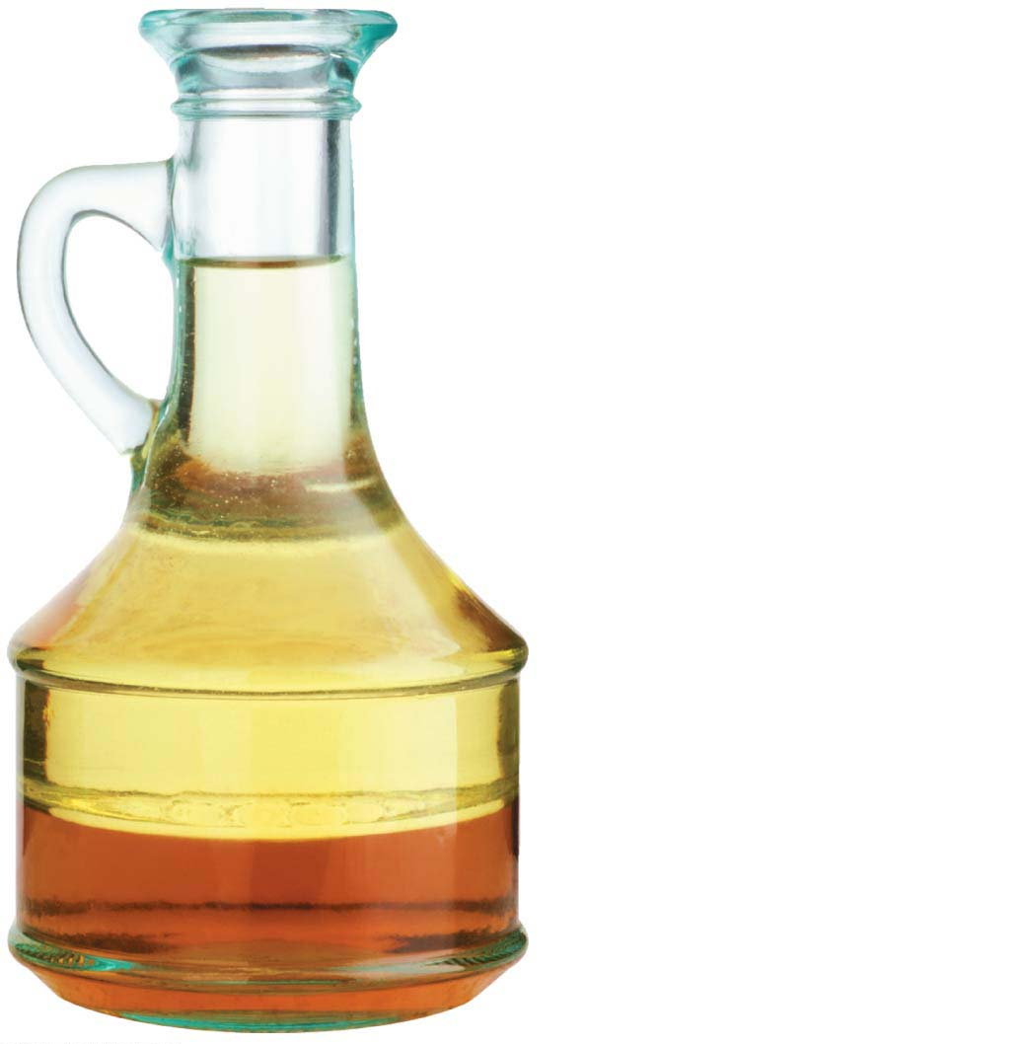
Oil (hydrophobic)
Vinegar (hydrophilic)
Notes:
Figure 3.10 The separation of hydrophobic (oil) and hydrophilic (vinegar) components in salad dressing

Slide 54
Lipids
Lipids also differ from carbohydrates, proteins, and nucleic acids in that they are neither huge macromolecules nor are they necessarily polymers built from repeating monomers.
Lipids are a diverse group of molecules made from different molecular building blocks.
Notes:
54

Slide 55
Fats
A typical fat, or triglyceride（甘油三酯）, consists of a glycerol（甘油） molecule joined with three fatty acid（脂肪酸） molecules via a dehydration reaction.
Notes:
55

Slide 56
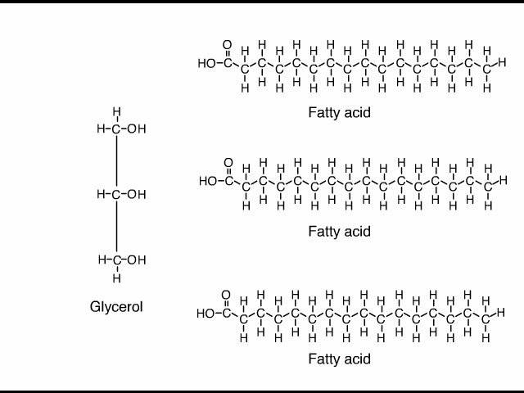
Animation: Fats

Slide 57
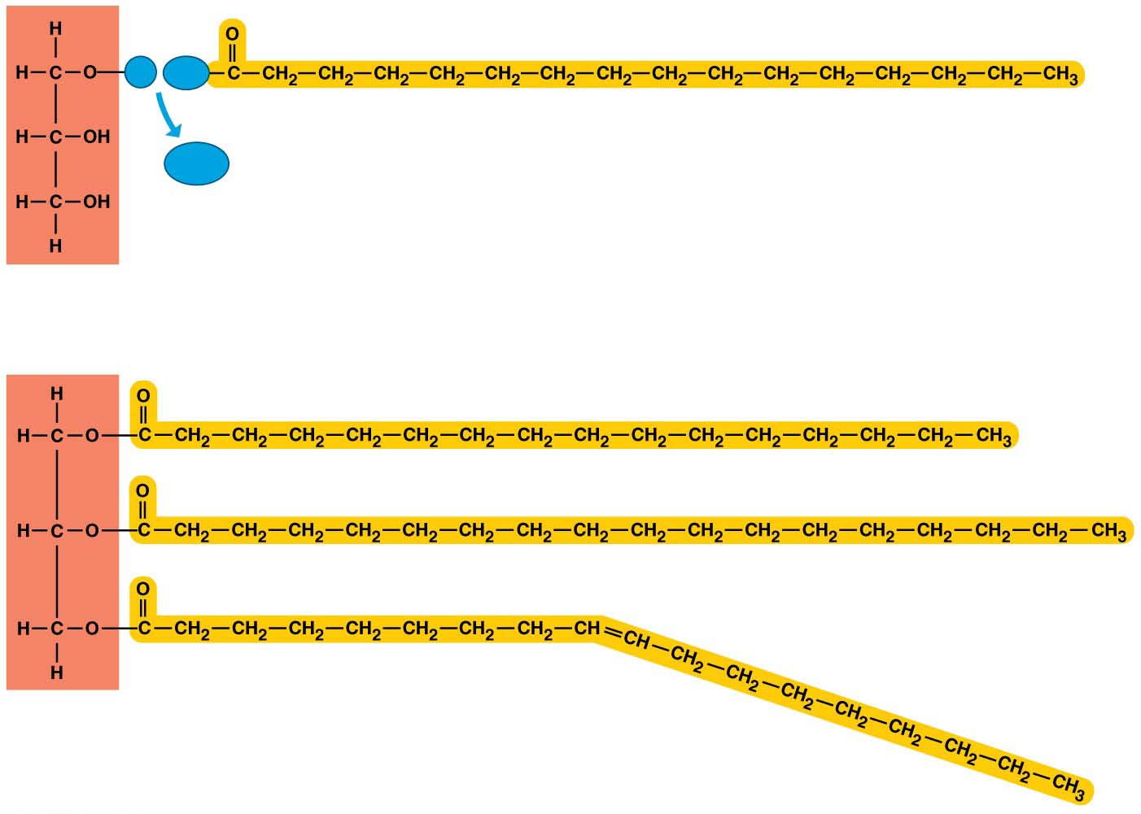
Figure 3.11
H
HO
Fatty acid
H₂O
Glycerol（甘油）
(a) A dehydration reaction linking a fatty acid to glycerol
(b) A fat molecule with a glycerol “head” and three
energy-rich hydrocarbon fatty acid “tails”
Notes:
Figure 3.11 The synthesis and structure of a triglyceride molecule

Slide 58
Fats
Fats perform essential functions in the human body including
energy storage,
cushioning, and
Insulation（隔热，保温）.
Notes:
58

Slide 59
Fats
If the carbon skeleton of a fatty acid has fewer than the maximum number of hydrogens at the double bond, it is unsaturated（不饱和的）.
If it has the maximum number of hydrogens, it is saturated（饱和的）.
A saturated fat has all three of its fatty acids saturated.
Notes:
59

Slide 60
Fats
Most animal fats
have a relatively high proportion of saturated fatty acids,
can easily stack, tending to be solid at room temperature, and
contribute to atherosclerosis（动脉硬化）, in which lipid-containing plaques（斑块） build up along the inside walls of blood vessels（血管）.
Notes:
60

Slide 61
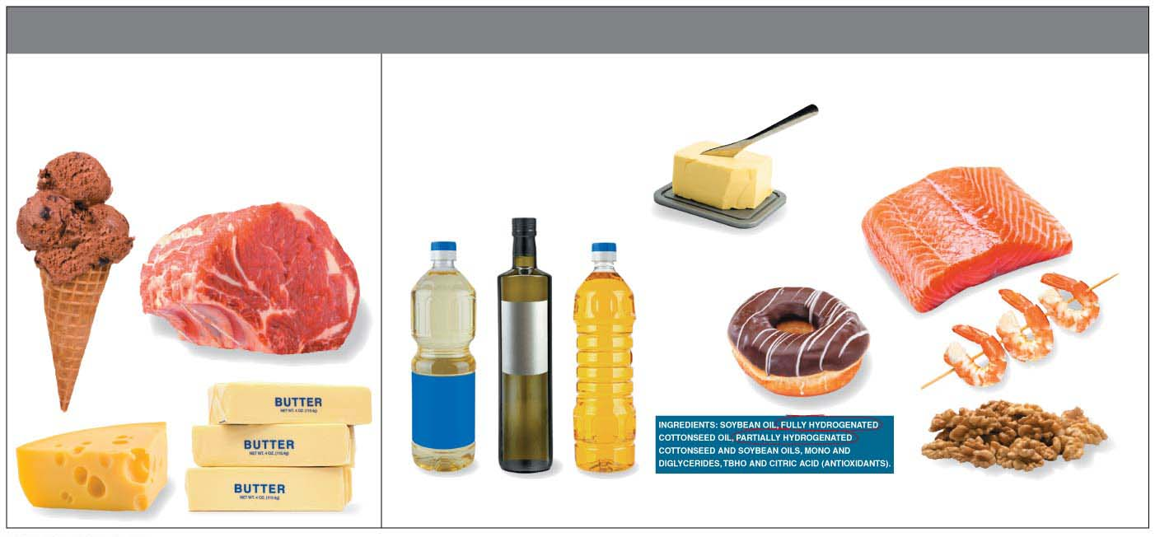
TYPES OF FATS
Saturated Fats
Unsaturated Fats
Margarine（人造黄油）
Plant oils
Trans fats
（反式脂肪）
Omega-3 fats
Notes:
Figure 3.12 Types of fats

Slide 62
Fats
Most plant and fish fats tend to be
high in unsaturated fatty acids and
liquid at room temperature.
Notes:
62

Slide 63
Fats
Hydrogenation（加氢作用）
adds hydrogen,
converts unsaturated fats to saturated fats,
makes liquid fats solid at room temperature, and
creates trans fats, a type of unsaturated fat that is particularly bad for your health.
Notes:
63

Slide 64
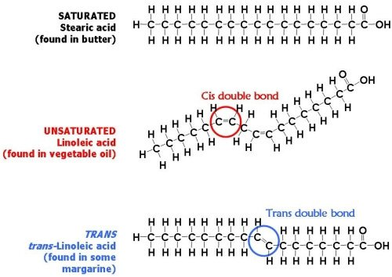

Slide 65
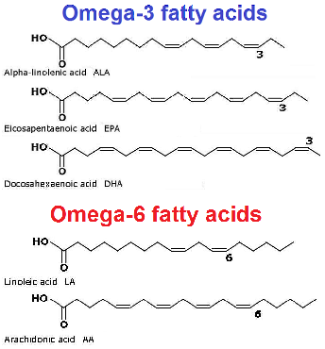

Slide 66
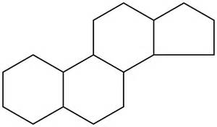
Steroids（类固醇）
Steroids are very different from fats in structure and function.
The carbon skeleton has four fused rings.
Steroids vary in the functional groups attached to this set of rings, and these chemical variations affect their function.
Notes:
66

Slide 67
Steroids
Cholesterol（胆固醇） is
a key component of cell membranes and
the “base steroid” from which your body produces other steroids, such as estrogen（雌激素） and testosterone（睾丸激素）.
Notes:
67

Slide 68
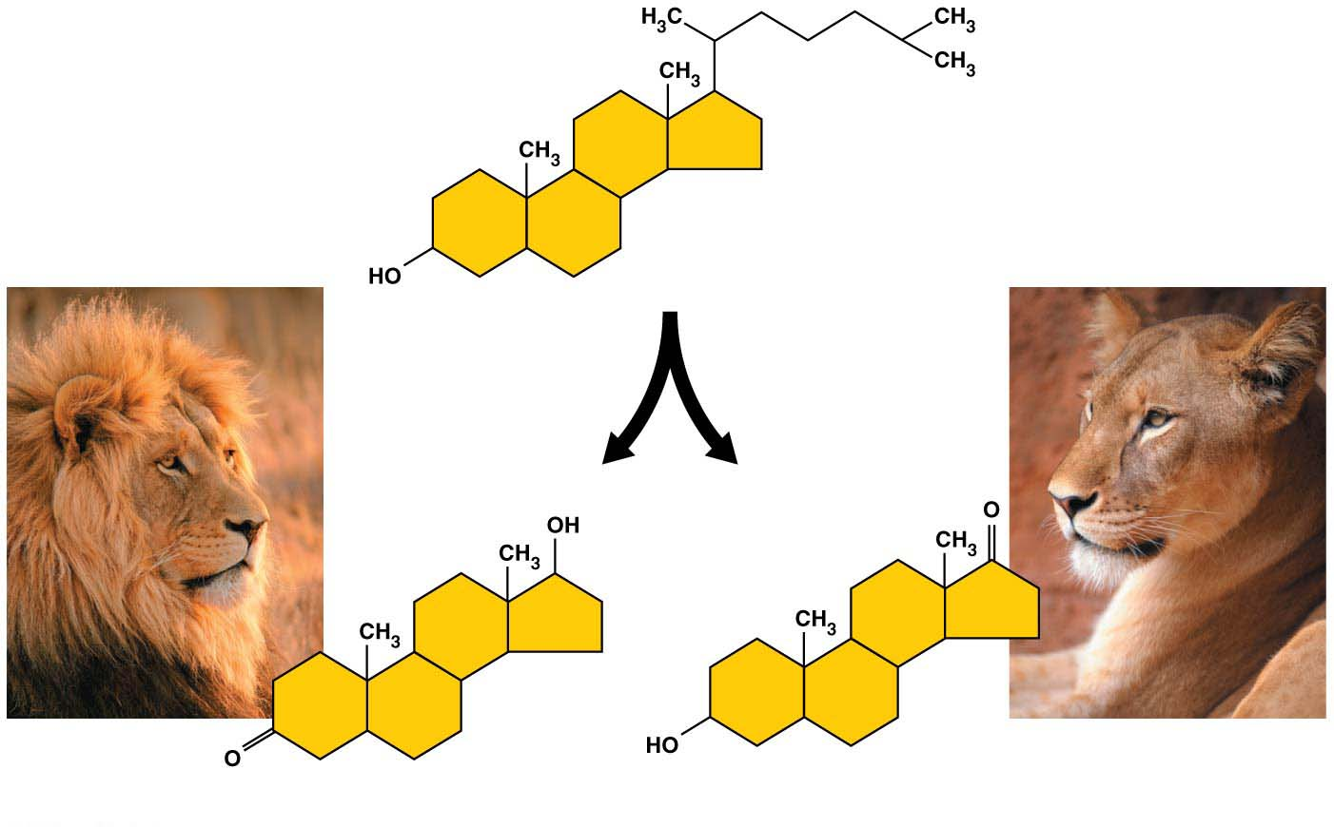
Cholesterol （胆固醇）
can be converted
by the body to
Testosterone
Estrone
(A type of estrogen)
Notes:
Figure 3.13 Examples of steroids

Slide 69
Steroids
Synthetic anabolic steroids（合成类固醇）
are variants of testosterone,
mimic some of its effects,
may be prescribed to treat diseases such as cancer and AIDS,
are abused by athletes to build up their muscles quickly,
can cause serious physical and mental problems.
Notes:
69

Slide 70
Steroids
Most athletic organizations ban the use of anabolic steroids because of their many potential health hazards coupled with the unfairness of an artificial advantage.
Notes:
70

Slide 71
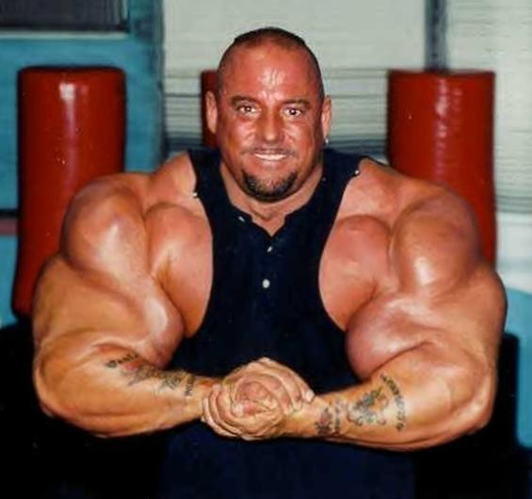

Slide 72
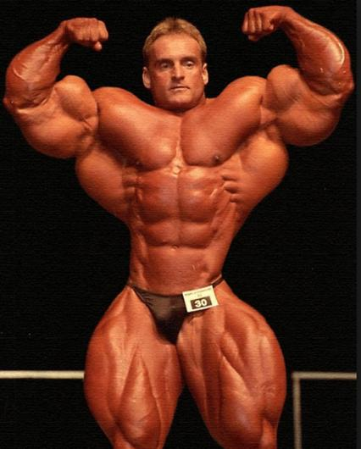

Slide 73
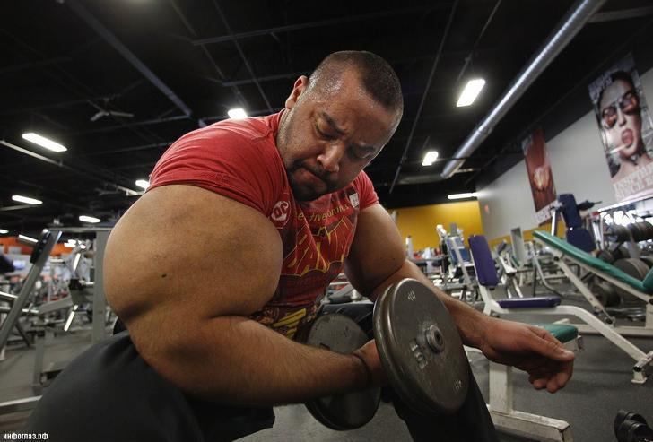

Slide 74


Slide 75
Proteins（蛋白质）
Proteins
are polymers of amino acid（氨基酸） monomers（单体）,
account for more than 50% of the dry weight of most cells, and
are instrumental in almost everything cells do.
Notes:
75

Slide 76
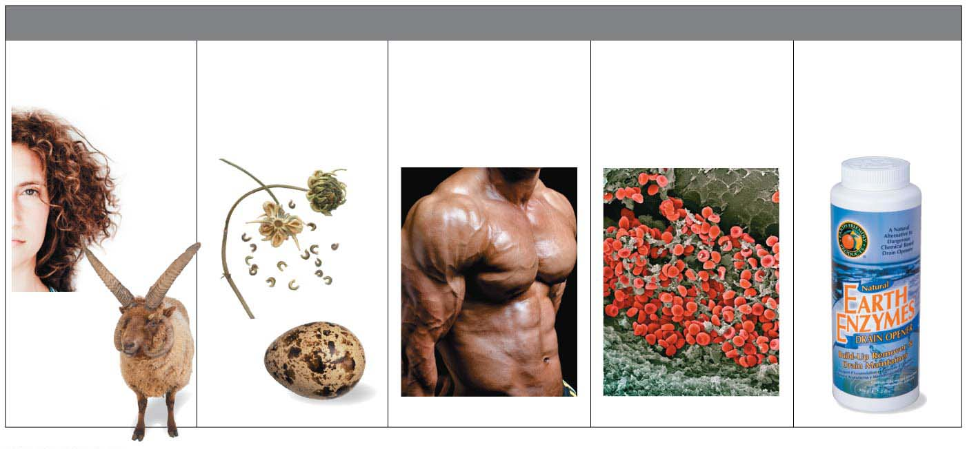
MAJOR TYPES OF PROTEINS
Structural Proteins
(provide support)
Storage Proteins
(provide amino
acids for growth)
Contractile
Proteins（收缩蛋白）
(help movement)
Transport Proteins
(help transport
substances)
Enzymes
(help chemical
reactions)
Notes:
Figure 3.15 Some of the varied roles played by proteins

Slide 77
The Monomers of Proteins: Amino Acids
All proteins are made by stringing together a common set of 20 kinds of amino acids.
Every amino acid consists of a central carbon atom bonded to four covalent partners.
Notes:
77

Slide 78
The Monomers of Proteins: Amino Acids
Three of those attachment groups are common to all amino acids:
a carboxyl group (−COOH),
an amino group (−NH₂), and
a hydrogen atom.
The variable component of amino acids
is called the side chain and
is attached to the fourth bond of the central carbon.
Notes:
78

Slide 79
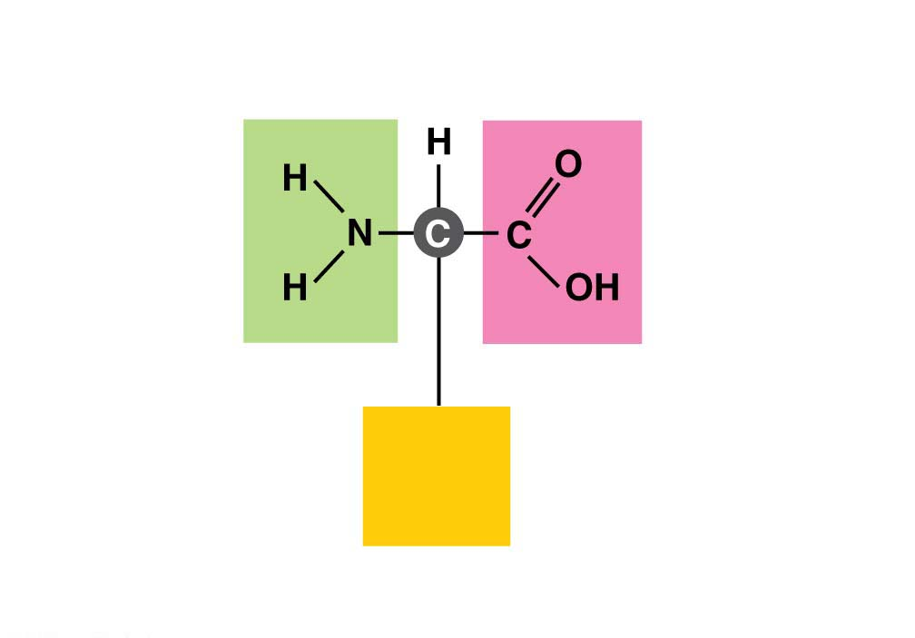
Amino
group
Carboxyl
group
Side
chain
(a) The general structure of an amino acid
Notes:
Figure 3.16-1 Amino acids (part 1: general structure)

Slide 80
The Monomers of Proteins: Amino Acids
Each type of amino acid has a unique side chain, which gives that amino acid its special chemical properties.
Notes:
80

Slide 81
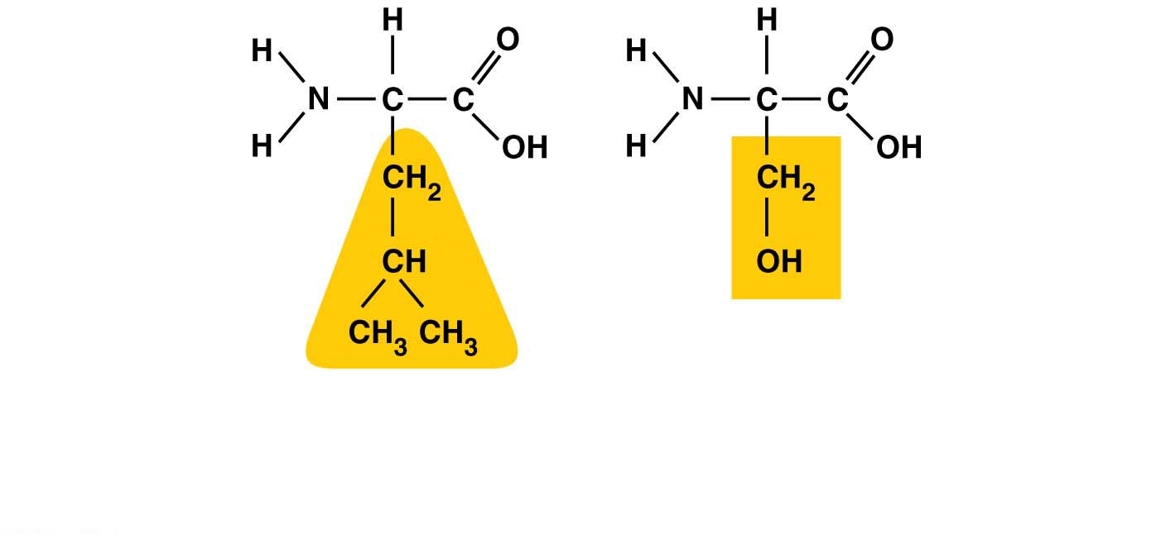
Hydrophobic
side chain
Hydrophilic
side chain
Leucine（亮氨酸）
Serine（丝氨酸）
(b) Examples of amino acids with hydrophobic and hydrophilic side chains.
Notes:
Figure 3.16-2 Amino acids (part 2: side chain examples)

Slide 82
Structure/Function: Protein Shape
Cells link amino acids together by dehydration reactions,
forming peptide bonds（肽键）, and
creating long chains of amino acids called polypeptides（多肽）.
A functional protein is one or more polypeptide chains precisely twisted, folded, and coiled into a molecule of unique shape.
Notes:
82

Slide 83
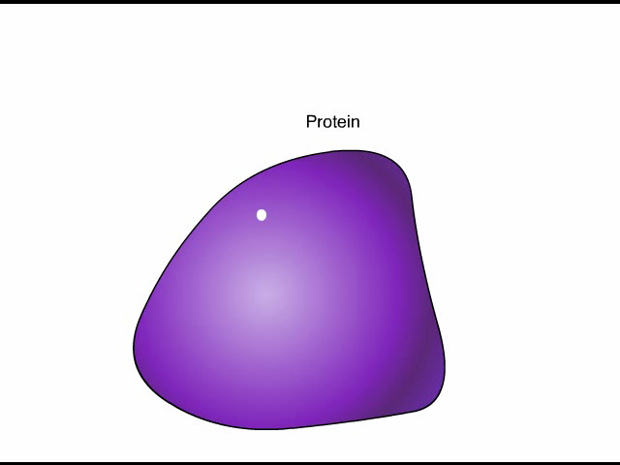
Animation: Protein Structure Introduction

Slide 84
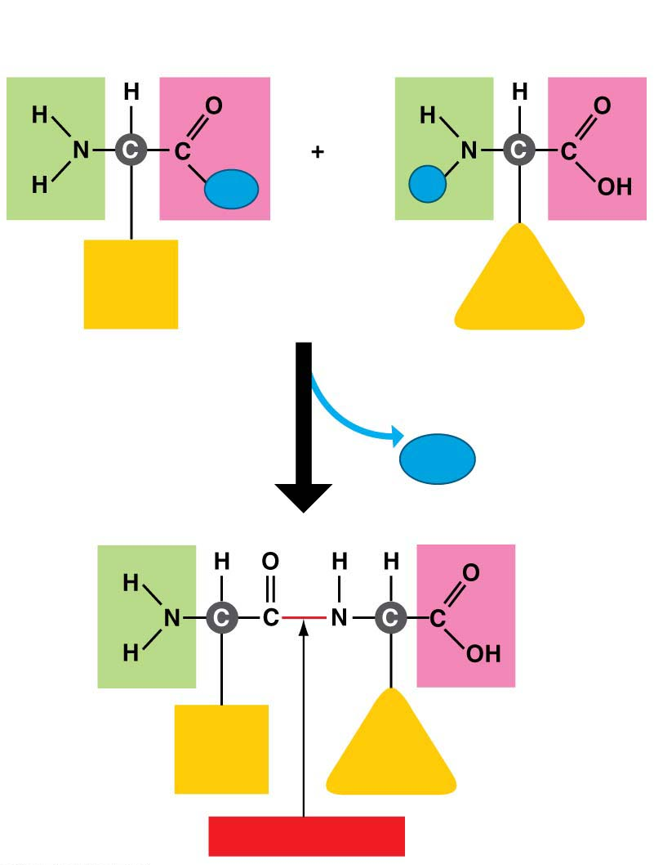
Carboxyl
group
Amino
group
OH
H
Side
chain
Side
chain
Amino acid
Amino acid
Dehydration reaction
H₂O
Side
chain
Side
chain
Peptide bond
Notes:
Figure 3.17-s2 Joining amino acids (step 2)

Slide 85
Structure/Function: Protein Shape
How is it possible to make the huge variety of proteins found in your body from just 20 kinds of amino acids?
Like the English alphabet used to make different words by varying the sequent of just 26 letters, proteins use 20 different “letters” (amino acids) to create polypeptides hundreds or thousands of amino acids in length.
Notes:
85

Slide 86
Structure/Function: Protein Shape
The amino acid sequence of each polypeptide determines the three-dimensional structure of the protein.
A protein’s three-dimensional structure enables the molecule to carry out its specific function.
Nearly all proteins work by recognizing and binding to some other molecule.
Notes:
86

Slide 87
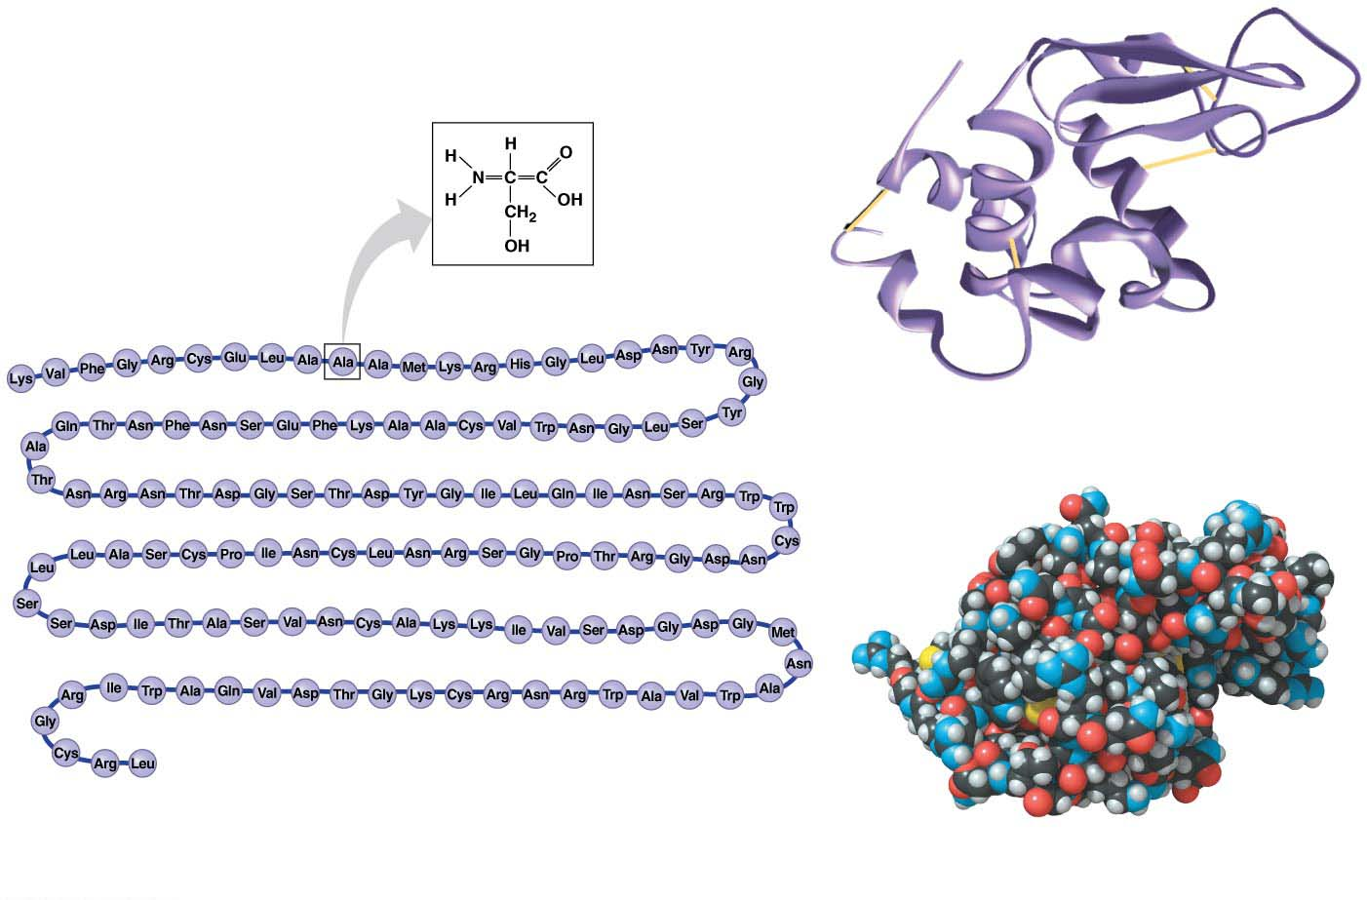
One amino acid
(alanine)（丙氨酸）
1
Here you can see how the polypeptide（多肽）
folds into a compact shape.
129
The amino acid sequence of lysozyme（溶菌酶）
This model allows you to see the details
of the protein’s structure.
Notes:
Figure 3.18 The structure of a protein

Slide 88
Four Level of Protein Structure:
Primary Structure (is simply the order of amino acids in the peptide chain)
Secondary Structure (2-dimensional structures formed due to hydrogen boding between hydrogen of amine group and oxygen of the carbonyl groups)
Tertiary Structure (involves the three-dimensional folding of a protein due to interactions of amino acid side chains)
Quaternary Structure (involves the association of two or more polypeptides into functional proteins)

Slide 89
Structure/Function: Protein Shape
A slight change in the amino acid sequence can affect a protein’s ability to function.
The substitution of one amino acid for another at a particular position in hemoglobin（血红蛋白）, the blood protein that carries oxygen, causes sickle-cell disease（镰刀型细胞贫血症） , an inherited blood disorder.
Notes:
89

Slide 90
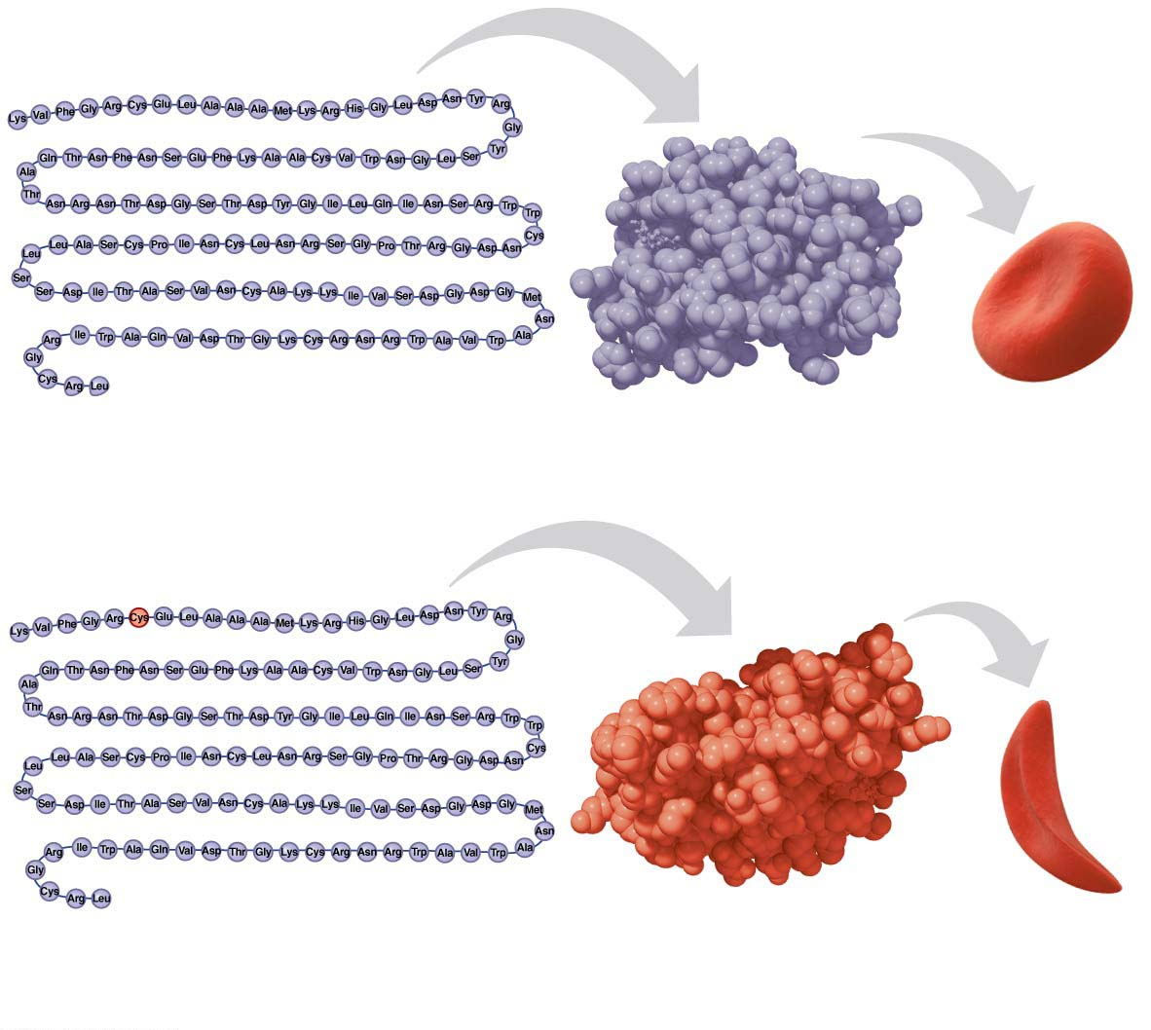
SEM
Amino acid sequence
Normal peptide
Normal red
blood cell
(a) Normal hemoglobin（血红蛋白）
SEM
Amino acid sequence
Sickle-cell
Sickled red
blood cell
polypeptide
(b) Sickle-cell hemoglobin
Notes:
Figure 3.19 A single amino acid substitution in a protein causes sickle-cell disease

Slide 91
Structure/Function: Protein Shape
One difference in structure is enough to cause the protein to fold into a different shape, which alters its function, which in turn causes disease.
Misfolded proteins are associated with many diseases, including some severe nervous system disorders.
The diseases shown in next Figure are all caused by prions（朊病毒）, misfolded versions of normal brain proteins.
Notes:
91

Slide 92
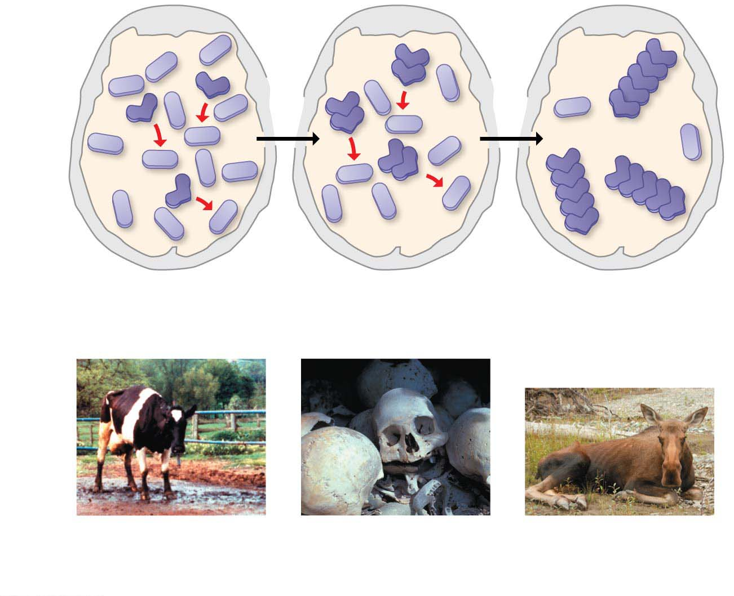
Normal
protein
Prion
Clusters
of prions
Skull
（头盖骨）
Prion
converts
normal
proteins
Prion
proteins
clump
together
Brain
Bovine spongiform
encephalopathy
(BSE)（疯牛病）
Kuru
Fatal weight loss in
deer, elk, and moose
Notes:
Figure 3.20 How an improperly folded protein can lead to brain disease

Slide 93
Structure/Function: Protein Shape
A protein’s shape is sensitive to the environment. An unfavorable change in temperature, pH, or some other factor can cause a protein to unravel.
Notes:
93

Slide 94
Nucleic Acids
Nucleic acids（核酸） are macromolecules that
store information and
provide the instructions for building proteins.
They consist of two types:
DNA (deoxyribonucleic acid)
RNA (ribonucleic acid).
Notes:
94

Slide 95
Nucleic Acids
The genetic material that humans and all other organisms inherit from their parents consists of giant molecules of DNA.
The DNA resides in the cell as one or more very long fibers called chromosomes（染色体）.
Notes:
95

Slide 96
Nucleic Acids
A gene is a unit of inheritance encoded in a specific stretch of DNA that programs the amino acid sequence of a polypeptide.
Those programmed instructions are written in a chemical code that must be translated
from “nucleic acid language”
to “protein language.”
Notes:
96

Slide 97

Gene
DNA
Nucleic
acids
RNA
Amino acid
Protein
Notes:
Figure 3.21 Building a protein

Slide 98
Nucleic Acids
Nucleic acids are polymers made from monomers called nucleotides（核苷酸）.
Each nucleotide has three parts:
a five-carbon sugar,
a phosphate group, and
a nitrogen-containing base.
Notes:
98

Slide 99

Nitrogenous base
(can be A, G, C, or T)
Connection
to the next
nucleotide
in the chain
Thymine (T)
Phosphate
group
Phosphate
Base
Sugar
(deoxyribose)
Connection to the
next nucleotide in
the chain
Sugar
(a) Atomic structure
(b) Symbol used in this book
Notes:
Figure 3.22 A DNA nucleotide

Slide 100
Nucleic Acids
Each DNA nucleotide has one of four possible nitrogenous bases:
adenine (A),
guanine (G),
thymine (T),
cytosine (C).
Notes:
100

Slide 101

Adenine (A)
Purines
Guanine (G)
Thymine (T)
Adenine (A)
Guanine (G)
Cytosine (C)
Pyrimidines
Thymine (T)
Cytosine (C)
Space-filling model of DNA
Notes:
Figure 3.23 The nitrogenous bases of DNA

Slide 102
Nucleic Acids
Dehydration reactions
link nucleotide monomers into long chains called polynucleotides,
form covalent bonds between the sugar of one nucleotide and the phosphate of the next, and
form a sugar-phosphate backbone.
Bases (A, T, C, or G) hang off the backbone like appendages.
Notes:
102

Slide 103

3‘
1’
2’
5’
4’
1’
3’
2’

Slide 104

Sugar-phosphate
backbone
Nucleotide
Bases
(a) DNA strand
(polynucleotide)
Notes:
Figure 3.24 The structure of DNA

Slide 105
Nucleic Acids
A molecule of cellular DNA is double-stranded, with two polynucleotide strands coiled around each other to form a double helix.
Bases along one DNA strand hydrogen-bond to bases along the other strand.
The functional groups hanging off the base determine which bases pair up:
A only pairs with T,
G only pairs with C.
Notes:
105

Slide 106
Base
pair
Hydrogen
bond
(b) Double helix
(two polynucleotide strands)
Notes:
Figure 3.24 The structure of DNA

Slide 107
Nucleic Acids
There are many similarities between DNA and RNA.
Both are polymers of nucleotides and
both are made of nucleotides consisting of
a sugar,
a phosphate, and
a base.
Notes:
107

Slide 108
Nucleic Acids
There are three important differences between DNA and RNA.
As its name ribonucleic acid denotes, the RNA sugar is ribose（核糖） rather than deoxyribose（脱氧核糖）in DNA.
Instead of the base thymine, RNA has a similar but distinct base called uracil (U).
RNA is usually found in single-stranded form, whereas DNA usually exists as a double helix.
Notes:
108

Slide 109

Nitrogenous base
(can be A, G, C, or U)
Connection to the next
nucleotide in the chain
Uracil (U)
Phosphate
group
Sugar (ribose)
Connection to the next
nucleotide in the chain
Notes:
Figure 3.25 An RNA nucleotide

Slide 110

The Process of Science: Does Lactose Intolerance Have a Genetic Basis?
DNA
Lactase gene
C or T
C- intolerance
T- tolerance
Human cell
Chromosome 2
Section of
chromosome 2
Notes:
Figure 3.26 A genetic cause of lactose intolerance

Slide 111
Some Review Slides

Slide 112

H₂O
OH
H
Short polymer
Monomer
Dehydration
reaction
H₂O
Hydrolysis
OH
H
Longer polymer
(a) Building a polymer chain
(b) Breaking a polymer chain
Notes:
Figure 3.4 Synthesis and breakdown of polymers

Slide 113

Starch granules
in potato tuber cells
(a) Starch
Glycogen granules
in muscle
tissue
Glucose
monomer
(b) Glycogen
Cellulose microfibrils
in a plant cell wall
(c) Cellulose
Cellulose
molecules
Hydrogen bonds
Notes:
Figure 3.9 Three common polysaccharides

Slide 114

Amino
group
Carboxyl
group
Side
chain
(a) The general structure of an amino acid
Hydrophobic
side chain
Hydrophilic
side chain
Leucine
Serine
(b) Examples of amino acids with hydrophobic and hydrophilic
side chains
Notes:
Figure 3.16 Amino acids

Slide 115
Sugar-phosphate
backbone
Base
pair
Nucleotide
Hydrogen
bond
Bases
(a) DNA strand
(polynucleotide)
(b) Double helix
(two polynucleotide strands)
Notes:
Figure 3.24 The structure of DNA

Slide 116

H₂O
Dehydration
OH
H
Short polymer
Monomer
Hydrolysis
Longer polymer
H₂O
Notes:
Figure 3.UN01 Summary of key concepts: polymers

Slide 117

Large Biological
Molecules
Functions
Components
Examples
Monosaccharides:
glucose, fructose;
disaccharides:
lactose, sucrose;
polysaccharides:
starch, cellulose
Dietary energy;
storage; plant
structure
Carbohydrates
Monosaccharide
Long-term
energy storage
(fats);
hormones
(steroids)
Fats (triglycerides);
steroids
(testosterone,
estrogen)
Fatty acid
Lipids
Glycerol
Components of
a triglyceride
Amino
group
Carboxyl
group
Enzymes, structure,
storage, contraction,
transport, etc.
Lactase
(an enzyme);
hemoglobin（血红蛋白）
(a transport protein)
Proteins
Side
chain
Amino acid
Phosphate
Information
storage
Base
Nucleic acids
DNA, RNA
Sugar
Nucleotide
Notes:
Figure 3.UN02 Summary of key concepts: large biological molecules

Slide 118

Carbohydrates
Functions
Components
Examples
Monosaccharides:
glucose, fructose;
disaccharides:
lactose, sucrose;
polysaccharides:
starch, cellulose
Dietary energy;
storage; plant
structure
Monosaccharide
Notes:
Figure 3.UN02a Summary of key concepts: large biological molecules (part 1: carbohydrates)

Slide 119

Base
Phosphate
group
Sugar
DNA
double helix
DNA strand
DNA nucleotide
Notes:
Figure 3.UN03 Summary of key concepts: nucleic acids

